Slide 1
Status of key on an AWT window

Slide 2
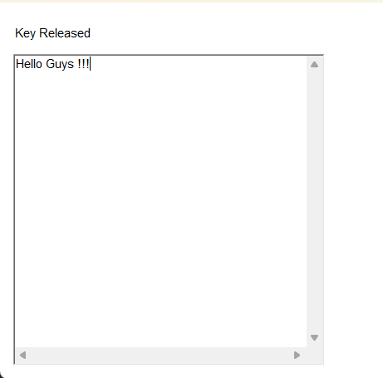
Desired Output :

Slide 3
The KeyListener Interface
It is used for receiving keyboard events from the user
This interface defines 3 methods :
keyPressed()
keyReleased()
keyTyped()

Slide 4
The keyPressed() and keyReleased() methods are invoked when a key is pressed and released respectively.
The keyTyped() method is invoked when a character has been entered
For example : If a user presses and releases the A key, three events are generated in sequence: keyPressed(), keyTyped() and keyReleased().
If a user presses and releases the HOME key, two key events are generated in sequence: keyPressed() and keyReleased()

Slide 5
The general form of these methods are as shown:
void keyPressed(KeyEvent e)
void keyReleased(KeyEvent e)
void keyTyped(KeyEvent e)
A KeyEvent is generated when keyboard input occurs.
Remember, not all keypresses result in characters. For ex : pressing SHIFT does not generate a character.

Slide 6
Import statements
1. import java.awt.*;
The java.awt package provides classes for creating and managing GUIs
2. import java.awt.event.*;
The java.awt.event package contains classes and interfaces for handling events in java

